Slide 1
Debt and Deficit
Formulas and figures?
Why is fiscal deficit bad?
FRBM Act provisions?
Why Public Debt Management Agency?
Economic Survey Vol1.ch2 and 10; vol-2-ch-2
14th Finance commission

Slide 2
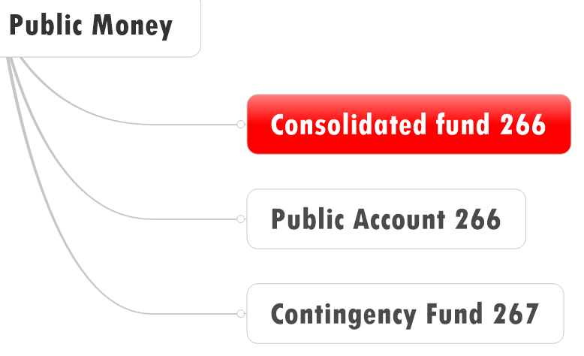
Debt
Total Liabilities
Public Debt
Other liabilities
NSSF, PLI

Slide 3
Revenue deficit (RD)
Tax Receipt
Non-Tax
Plan
Non Plan
Revenue Receipts
Revenue Expenditure
RD: 0 | positive | Negative

Slide 4
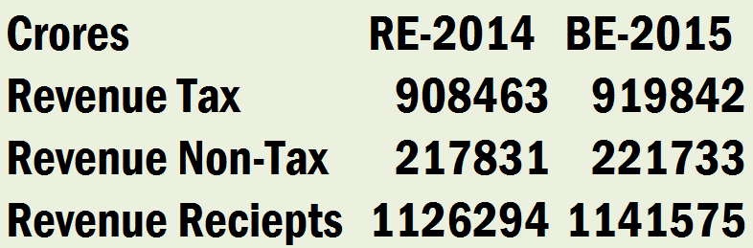
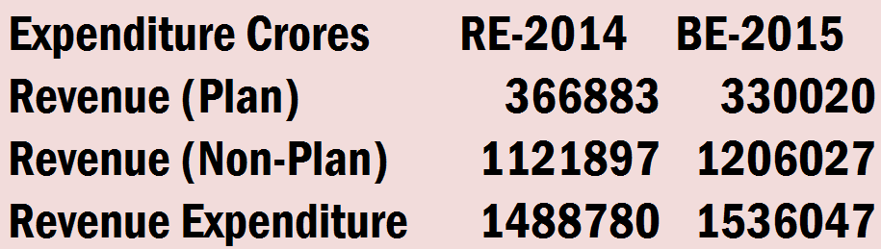
Revenue incoming
Revenue outgoing
रट्टा मारो जिंदाबाद (revenue)
Incoming: Tax > non-tax
Outgoing: Non-plan > plan
NET: Expenditure > Receipts

Slide 5

FRBM Act 2003
RD
Wanted to curb revenue deficit to 0% of GDP by 2008
FRBM amendment 2012
Revenue deficit….x
Effective revenue deficit 0%
by 2015, 31st March

Slide 6
Revenue deficit (RD)
Tax Receipt
Non-Tax
Grants to states for capital assets??
Revenue Receipts
Plan
Non Plan
Revenue Expenditure
RD: 0 | positive | Negative

Slide 7
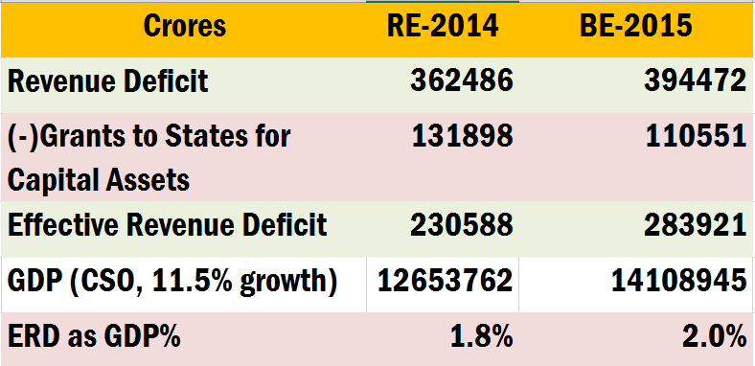
FRBM wanted 0% of GDP?
ERD

Slide 8
CSO computes
Growth (ABSOLUTE): crores
Growth Rate (%): compared to previous xyz year
Base year: 2004 2011
2014: 126,53,762 crores (7.4%)
2015: 11.5% more than 2014
1.115 x 126,53,762 crores
= 141,08,945 crores
GDP?

Slide 9
FRBM wanted 0% by 31st March 2015
Divide ERD / GDP (ABSOLUTE)

Slide 10
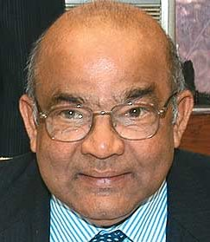
ERD Opposed
14th FC
RD=>ERD: Creative budgeting and accounting manipulations, to reach FRBM targets
Should replace ERD=> RD.
Target: 0% RD by 1/4/2015

Slide 11
Budgetary deficit (BD)
Revenue
Expenditure
Capital
Expenditure
Tax + Non
Debt +non
Revenue
receipts
Capital
receipts
Plan
Non Plan
Total Receipts
Total Expenditure
BD: 0 | -ve | +ve

Slide 12
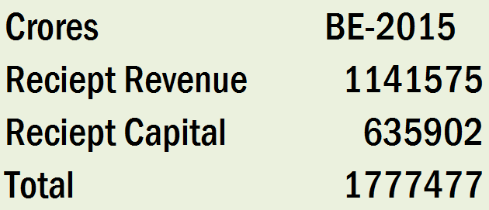
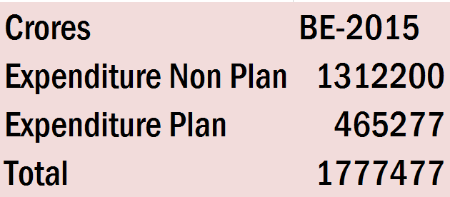
incoming
outgoing
रट्टा मारो जिंदाबाद
RR> CR
NP_EXDR>P_EXDR
BD=0

Slide 13
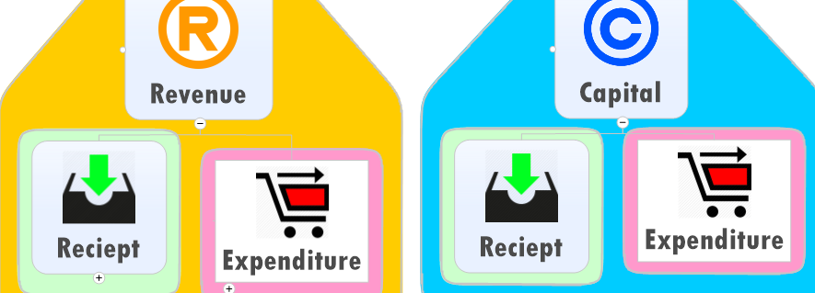
How Budget Deficit=0?
borrowing
How to get zero answer?
BoP: capital surplus / RBI Forex reserve
Budget: borrowing (capital account)

Slide 14
Sukhmoy Chakravarti: 97-98
Fiscal Deficit
Budget Deficit
+ Market Borrowing

Slide 15
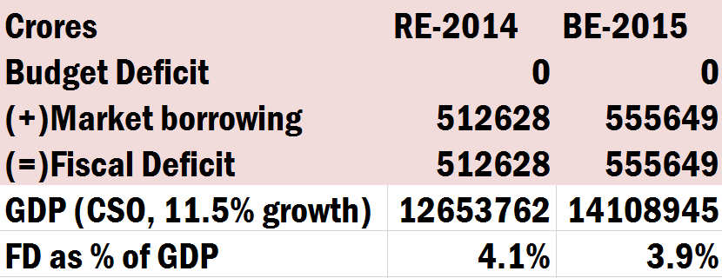
Fiscal Deficit (राजकोषीय)

Slide 16
Fiscal Deficit (राजकोषीय)

Slide 17
Fiscal deficit Target: delayed
Jaitley
target
FRBM, Survey, 14FC want 3%
Here by 31/3/2017

Slide 18
Primary deficit
Primary Deficit
Fiscal Deficit
- Interest Payments
Budget Deficit
+ Market Borrowing

Slide 19
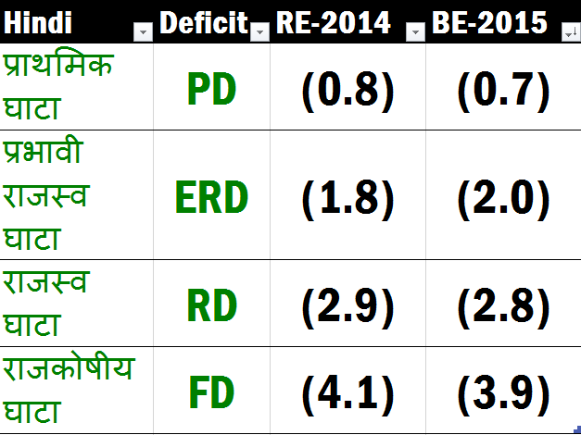
Verticle descending (GDP%)
-capital asset grant
-interest payment

Slide 20
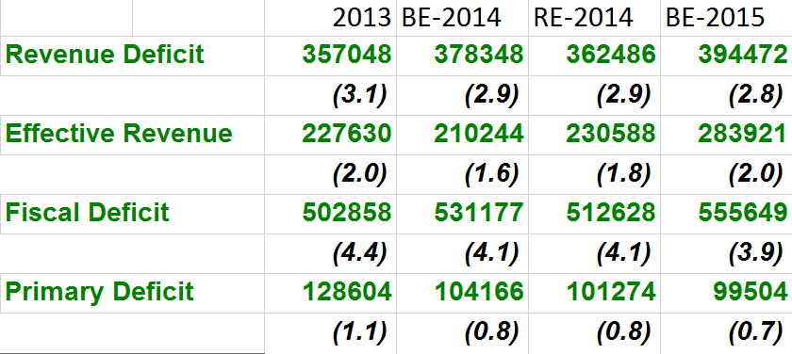
CAPF very trivial horizontal ascending descending

Slide 21
Debt and Deficit
Formulas and figures?
Why is fiscal deficit bad?

Slide 22
BoP Crisis
Junk Status: future borrowing expensive
CAP.Surplus < Current deficit
sovereign rating ▼
FDI FII decline
bond yield ▲
Fiscal Deficit
Notes:
Toll tax, social unrest

Slide 23
UNEMPLOYMENT
utilities expensive
=purchasing power Down
FDI relax
Crowding Out
Privatization
G-Sec: financial repression
Infra. PPP
Fiscal Deficit
Notes:
Toll tax, social unrest

Slide 24
UNEMPLOYMENT
बेरोज़गारी
Expensive Loans
REPO increase
Inflation
Monetizing Deficit
Subsidy same
Fiscal Deficit
Notes:
Toll tax

Slide 25
Gold/Real Estate
Black Money
Less Business expansion
Oil expensive
Inflation
Real Interest rates Negative
Inflation
Monetizing Deficit
Subsidy same
Fiscal Deficit
Notes:
Toll tax

Slide 26
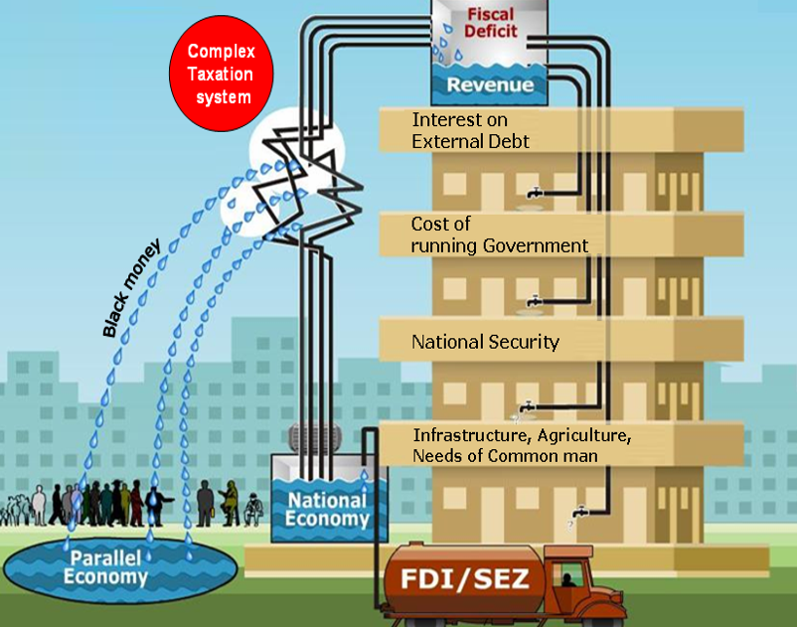

Slide 27
FRBM Act
Fiscal deficit is bad
How to contain it in timeframe?
Ans. Fiscal responsibility and budget Management act

Slide 28
FRBM Act 2003
Revenue deficit | 0% by 31/3/2008
fiscal deficit | 3% of GDP by 31/3/2009

Slide 29

Deadline Extended
FRBM
2012 amendment
ERD 0% => 2015, 31st March (14th FC wants RD)
FD 3% => 2017,31st March (Jatley will do in 2018, 31st March)

Slide 30
2006
Fiscal Responsibility and Budget Management Act (FRBMA) concerns with __.
Fiscal deficit only
Revenue deficit only
Both fiscal deficit and revenue deficit
Neither fiscal deficit nor revenue deficit

Slide 31
Twin Deficit
High CAD
High Fiscal Deficit
Seems improved

Slide 32
Reforms in Public Debt Management
FRBM: FD, ERD curb in deadline
Jaitley announced “PDMA”

Slide 33

Financial Repression
PDMA Why?
Public Debt => SLR, G-Sec to LIC/EPFO
Less return (~8%)
Less incentive in Financial assets
More investment in gold, real estate, overseas
RBI manages G-Sec, T-Bill = conflict of interest in combating inflation.

Slide 34
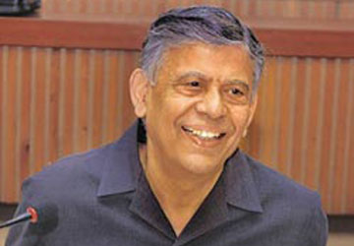
Financial Repression
Solution?
Public Debt Management authority
PDMA will sell G-Sec on voluntary basis
Same recommendations
Vijay Kelkar (13th FC)
Justice BN Srikrishna (FSLRC)
Sweden, NZ, Germany, Denmark etc have similar.

Slide 35

TIMELINE
PDMA
2011: bill, but not passed.
Interim budget proposed Non-statutory PDMA (1/4/2014) but regime change
Previous Economic Survey recommended

Slide 36
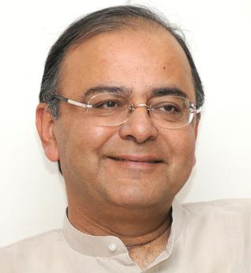
Budget 2015
PDMA
Announced PDM-Agency
Manage Both internal and external borrowing of Government
Have to amend G-Sec Act, RBI Act.

Slide 37
Deficit formulas and figures
Why FD bad, FRBM targets?
PDMA

Slide 38
Fiscal deficit
Views of Economic Survey and 14th Finance commission

Slide 39
Fiscal deficit: past and future
14FC, Survey wants 3%
Jaitley
target

Slide 40
Survey Target: Increase Tax to GDP
GST implementation

Slide 41
Survey Target: Decrease Debt: GDP

Slide 42
14th FC: Fiscal deficit target

Slide 43
Kelkar
13FC
States FD target: 3% GSDP, but 13 states failed
Combed FD (State + Union): 5% GDP, both failed

Slide 44

Income has to ▲ BUT….
3% target
fiscal stimulus Post 2008 global slowdown
Tax breaks, exemption: 5 lakh cr. Revenue forgone (2012-13)
But policy paralysis= GDP growth poor
So, indirect taxes growth poor
Import bill increased but many items get 'exempted' from taxes
Gold duty hiked but smuggling

Slide 45
Income has to ▲ BUT….
3% target
BE-2014 vs RE-2014: revenue shortfall
Postal Department making losses of ~7k per year.
Railways not making sufficient profit.
Same for many PSU

Slide 46
Income has to ▲ BUT….
3% target
Poor market response to Disinvestment
Rich PSE forced to declare higher dividends….but for how long?
Loan recovery difficult from states, post 12FC recommendations

Slide 47
Expenses have to ▼ BUT….
3% target
Implementation of 7th Pay commission (Justice AK Mathur, 2015-Oct)
Large subsidy bill & Leakages
To implement GST: 25k crores to States compensation.
Implementation of 14th FC will leave Union with less money (42% tax devolution)

Slide 48

Reforms DONE
3% FD target
CSS reduced to 66
Petrol diesel deregulated
Crude oil ▼=> Government ▲ Excise duty => more money.
LPG-Kerosene not deregulated BUT global prices ▼ => subsidy bill ▼
DBT for LPG + JAM Trinity

Slide 49

Reforms YET To DO
3% FD target
Shanta Kumar FCI
NFSA 67% population=> cover 40% only
Priority households- sell 50%MSP, not 1/2/3 per kilo

Slide 50
Yet to begin
3% target
Kelkar report on fiscal consolidation (2012)
GST: 1/4/2016
GAAR: 1/4/2017 (Shome)
PDMA
Spectrum auction: hoping 1 lakh crores (more in infra. lecture)
Coal block auction: hoping 100 billion$ for states (more in infra. lecture)

Slide 51
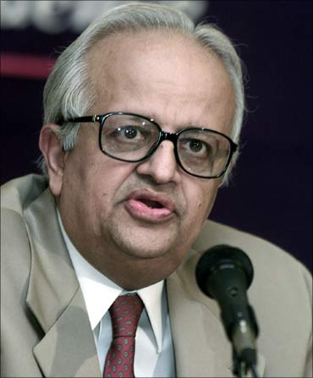
Expenditure Management commission
Bimal Jalan
2014, Sep: Ex-RBI governor Bimal Jalan
Sumit Bose (Ex-Fin Secretary)
Subir Gokarn (Ex-RBI-Dy-Gov)
2014, Dec: interim report
Full report expected by 2016 budget.

Slide 52
EXM Interim report Dec 2014
Bimal Jalan
Merge CSS
Post office as "payment banks"
DBT implement: 1 crore so far, cover 10 crore families
Stop distinction between plan vs non-plan
Effective monitoring of every rupee spent
Full report before budget 2016.

Slide 53
Salary REFORMs
14th FC
Budget outlay: link with outcomes
Pay commission rename to “Pay and Productivity Commission”
Salaries link with performance
Inter state council: “national policy on salaries and emoluments”
Compulsory NPS for new state Govt. employees

Slide 54
Accounting REFORMs
14th FC
Shift to Accrual based accounting
MIS portal to monitor both union and state accounts
Implement 2nd ARC points about internal-auditing
PSE reforms => future lecture on industrial sector

Slide 55
Various types of deficits
Why they’re bad for economy?
FRBM & other Targets

Slide 56
Negative/pending
Positive/Likely
Revenue shortfall
7PayC
Postal, Railways, PSE
Disinvestment
Jalan, Shanta, Kelkar (JSK!?)
14FC: salary + accounting + ERD=> RD
CSS reduced
JAM-DBT
Petro-Diesel dereg.
GST, GAAR, PDMA
Spectrum + Coal Auction

Slide 57
Black Money
ATR: swiss bodies- automated data exchange
Black money in Foreign assets
Black money in Desi assets
Tax Avoidance: GAAR

Slide 58

Held in foreign assets
Black Money
New law
Hiding black money in foreign assets upto 10 years jail
Penalty: 300% tax
Non-compoundable, Can't approach the Settlement Commission.
Even individuals, banks, NBFCs helping such people will be liable.

Slide 59
Held in foreign assets
Black Money
file return even if there is no taxable foreign asset
Else upto 7 years Jail + fine
Date of Opening foreign account
Third parties required to inform
Amend PMLA-2000 & FEMA-1999 to attach Indian properties IF foreign properties can't be attached.

Slide 60

Held in DESI assets
Black Money
A comprehensive Benami Transactions (Prohibition) Act: Real estate property - confiscation + penalty
IT act reform: immovable property sale- can't accept >20k in cash. ELSE penalty of equal amount.
^ TDS on above, with TAN #. (RI+ NRI also)
Must quote PAN number for transaction above Rs.1 lakh (earlier 50k)

Slide 61
Held in DESI assets
Black Money
CBDT and CBEC share database with each other
Leverage ICT technology
Monitor splitting in small transaction

Slide 62
Black Money
Black money on Foreign assets
Black money on Desi assets
Tax Avoidance: GAAR + others
Ease of doing business

Slide 63
Evasion
Avoidance
Income / transaction hidden
Black money
Jailtime
Reported, everything on file
But Legal loopholes used to avoid tax
Black money….?
Vodafone CGT

Slide 64

Vodafone PLC, London
Hutchinson HongKong
$ 11 bn
Rs. 55k cr
Vodafone, Netherland
CGP investment Holding, Cayman
Hutch Essar, India
Vodafone India
Feb. 2007
Notes:
Hutch Essar’s 67% stakes held by CGP investment ltd.

Slide 65
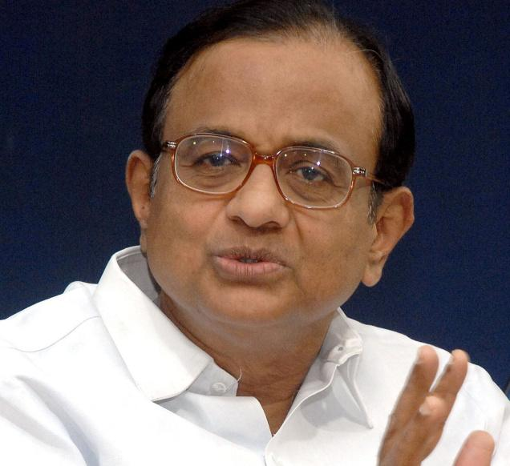
Vodafone PLC, London
Hutchinson HongKong
55-12=43
Vodafone, Netherland
CGP investment Holding, Cayman (67%)
12k Crore
Hutch Essar, India
Vodafone Essar India
Mar. 2007
Notes:
TDS at Source; actually Pranab Mukharjee

Slide 66

Vodafone PLC, London
Hutchinson HongKong
$ 11 bn
Rs. 55k cr
Entire Deal outside India
No sale/purchase of Indian company / its shares
Vodafone, Netherland
CGP investment Holding, Cayman
CGP not in any other business
Entire Deal to acquire Hutch-Essar
Hutch Essar, India
Vodafone India
Notes:
TDS at Source; actually Pranab Mukharjee

Slide 67
Budget 2012: GAAR
General Anti Avoidance Rules
WEF 1/4/2014
IT commissioner take action against tax avoidance
Indian Citizen, NRI, Foreigner
Even outside India
Even retrospective
Even if protected under any DTAA
Notes:
For more read the GAAR article on site
Parthsarthi shome
Shome (PM)
no penalty/interest in retrospective
only one rare cases
not to raise revenue for the government.

Slide 68
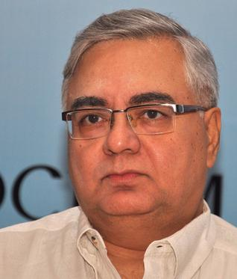
Budget 2012: GAAR
Avoidance
Shome Panel
Only in rare cases
>3 Cr. + tax benefit
Not to fill Revenue shortfalls
Defer till 2016 (P.C. accepted)
(2015) Jaitley=> 2 years
Not retrospective. Only from 1/4/2017 onwards
Notes:
For more read the GAAR article on site
Parthsarthi shome
Shome (PM)
no penalty/interest in retrospective
only one rare cases
not to raise revenue for the government.

Slide 69
Prevent Vodafone like cases
Budget-2015
SC: IT has no jurisdiction on CGT over indirect transfer overseas.
2012: Pranab amends IT act- if significant value derived from Indian assets. (Cayman company valued @55k Crore for 67% Indian shares held)
Jaitley clarifies in budget-2015

Slide 70
Only if 50% value derived
But not application in following scenarios
Indian asset worth Rs.10 crore or less
Foreign owner has no more than 5% voting power in Indian company
Merger-demergers
But Indian entity must report foreign ownerships

Slide 71
Vodafone PLC, London
Vodafone Teleservices India Holding Mauritius.
Vodafone, Netherland
1300 Crore
250 Crore
Vodafone India Services (VISPL)
2009-10
Notes:
VISPL= call centre
“transfer pricing” generally refers to prices of transactions between associated enterprises (AEs). These transactions may take place under conditions differing from those taking place between independent enterprises. According to the Department, the effect of transfer pricing is that the parent company or a specific subsidiary tends to produce insufficient taxable income or excessive loss on a transaction.

Slide 72
Vodafone Teleservices India Holding Mauritius.
Vodafone PLC, London
Vodafone, Netherland
3,200 Cr.
8500 Crore
Vodafone India Services (VISPL)
FY 2013
Notes:
VISPL= call centre
“transfer pricing” generally refers to prices of transactions between associated enterprises (AEs). These transactions may take place under conditions differing from those taking place between independent enterprises. According to the Department, the effect of transfer pricing is that the parent company or a specific subsidiary tends to produce insufficient taxable income or excessive loss on a transaction.

Slide 73
Transfer Pricing
Domestic Transfer pricing monitoring
Earlier: 5 crores
Now: 20 crores
Mid-size companies are not harassed in “Tax terrorism”.
Related Budget-2014 reform: arms length pricing, advance pricing reform click me

Slide 74
Ease of Doing Business
Budget 2015
Will setup commercial courts
For high value commercial disputes
Law commission (AP Shah) report
Need to amend Civil procedure code

Slide 75
Ease of Doing Business
Budget 2015
ITAT individual member Rs.15 lakh matter (5 lakh before)
Bankruptcy code: global standards
Tax on Royalty 25% => 10%
Corporate tax 30%=> 25%, to be at par with Asian economies.

Slide 76
Ease of Doing Business
Budget 2015
FDI-FPI no…just composite cap
Foreign investment permission-need to relax…will set Committee
FEMA reform for currency conversion

Slide 77
Black money in Foreign / Desi assets
Tax Avoidance: GAAR + others
NEXT: Why DTC dropped?

Slide 78
DTC 2013 revised guideline (‘14)
DTC bill 2010
Standing committee on finance
Their suggestion => update DTC Bill 2013
indirect transfers should be taxed in India
if company’s 50% assets in India
CGP investment => Hutch-Essar (67%)
Budget 2015 incorporated….so no more need

Slide 79
DTC other proposals
taxable income | right now | DTC proposed
2-5 lakh | 10 | 10
>5 lakh | 20 | 20
>10 lakh | 30 | 30
>10 crore |  | 35
dividend >1 crore | -- | additional 10%
Wealth Tax >30 lakh, 1% | only physical assets | physical financial
Shares, bonds, FD, MF, ULIP
Notes:
Wealth tax- Additional to capital gains
Senior citizen 65=>60
This tax is payable if the market value of certain assets exceeds 30 lakh. The tax is 1% of the combined value of such assets.
productive and financial assets, such as commercial property, bonds, fixed deposits, stocks, Ulips, gold funds, mutual funds,

Slide 80
Why DTC idea dropped?
Indirect transfer clarified
Wealth tax Removed
More surcharge on super wealthy
Interview Q: suggest addl.reforms
Indirect transfer atleast 50% value
but what if two postbox companies with 25%+25%
super tax on BCCI, IPL and religious babas?
Followup: Banking transaction tax?

Slide 81
BTT
Features
why bogus idea?

Slide 82
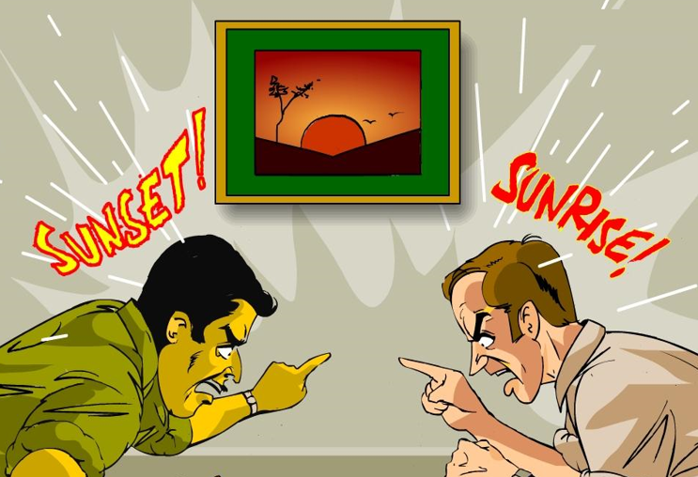

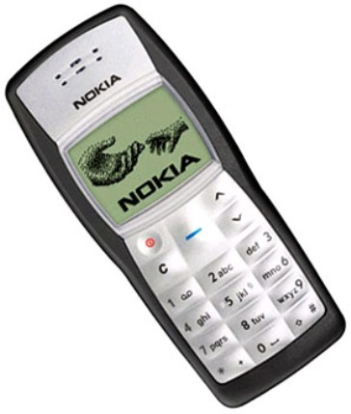

Present Tax system: Why Deficient?
Multiple Interpretation
Tax avoidance high
Litigations for years
Notes:
35-40k capital gains tax evaded

Slide 83
Avoidance + evasion =High level of fiscal deficit

Slide 84
BTT: Features (Pune-Arthakranti + Ramdev Baba)
Abolish all 56 taxes Except IMPORT duty
Withdraw currency >50 Rs.
Prohibit cash transaction above Rs.2000
only Bank, DD, Netbanking, Credit card
2% tax on such banking transaction
Only for “credit/debit”; Not for “deposit / withdrawal”
Notes:
All direct

Slide 85
Sharing
Why bad?
Union left with less money
Defense- healthcare suffer
Banks don’t deserve 0.35%
BTT | Share
Union | 0.70%
State | 0.60%
Local | 0.35%
Bank | 0.35%
Total | 2%

Slide 86
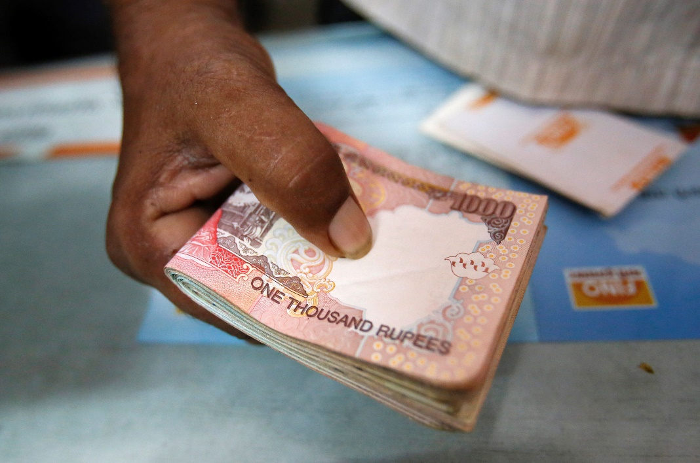

> 2000 transaction =no cash
Barter
Gold, Hawala
Foreign Currency
Digital currency (BitCoints)

Slide 87

> 2000 transaction =no cash
Legally
2500 => Rs. 50 BTT (2%)
Loophole
2000 diesel (cash) 1/1/2014
500 diesel (cash) 2/1/2014

Slide 88
BAD
GOOD
Direct tax: progressive
Indirect : regressive
BTT (2%): Flat => regressive => hurts poor more
Taxes abolished=> Petrol, Diesel, FMCG cheaper (35-50%)
Higher demand=> more jobs => GDP

Slide 89



decrease consumption of Bad products?
Present
BTT
Gold, Cigar, Gutka, Liquor
Higher taxes to decrease consumption
Not possible.
2% uniform
Notes:
FMCG 35-50% reduce

Slide 90

Why bad idea?
BTT
Model failed in Australia, Argentina, Brazil. They reverted to conventional tax system
7th Sch. Has to be amended drastically
Special majority of parliament
+50% of Vidhan Sabhas
GST difficult…forget BTT

